Slide 1
Chi-Square Tests
Chapter 12
Chap 12-<number>

Slide 2
Learning Objectives
In this chapter, you learn:
How and when to use the chi-square test for contingency tables
How to test multiple proportions
How to test for independence
Chap 12-<number>

Slide 3
Contingency Table Example
Left-Handed vs. Gender
Dominant Hand: Left vs. Right
Gender: Male vs. Female
2 categories for each variable, so this is called a 2 x 2 table
Suppose we examine a sample of
300 children
Chap 12-<number>

Slide 4
Contingency Table Example
(continued)
Sample results organized in a contingency table:
Gender | Hand Preference
 | Left | Right
Female | 12 | 108 | 120
Male | 24 | 156 | 180
 | 36 | 264 | 300
sample size = n = 300:
120 Females, 12 were left handed
180 Males, 24 were left handed
Chap 12-<number>

Slide 5
Test for the Equality Between Proportions
H₀: π₁ = π₂ (Proportion of females who are left
handed is equal to the proportion of
males who are left handed)
H₁: π₁ ≠ π₂ (The two proportions are not the same –
hand preference is not independent
of gender)
If H₀ is true, then the proportion of left-handed females should be the same as the proportion of left-handed males. Left-handedness is then independent of gender.
Chap 12-<number>

Slide 6
General Problem –
Test of Independence
H₀: The two categorical variables are independent
(i.e., there is no relationship between them)
H₁: The two categorical variables are dependent
(i.e., there is a relationship between them)
Each variable may have more than two categories, extending to contingency tables with r rows and c columns
Chap 12-<number>

Slide 7
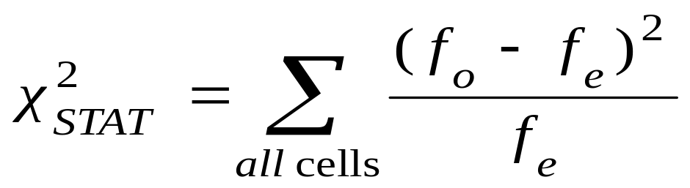
The Chi-Square Test Statistic
The Chi-square (χ²) test statistic is:
where:
f_{o} = observed frequency in a particular cell of the r x c table
f_{e} = expected frequency in a particular cell if H₀ is true (next slide)
(Assumed: each cell in the contingency table has expected
frequency of at least 1. Otherwise, merge some categories.)
Chap 12-<number>

Slide 8
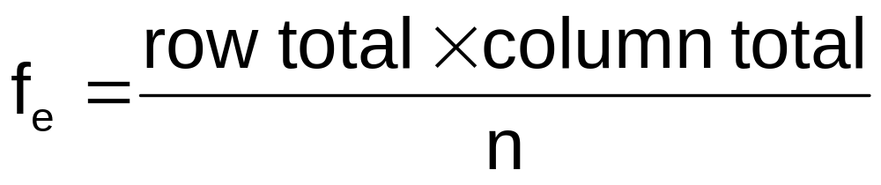
Expected Cell Frequencies
Expected cell frequencies:
Where:
row total = sum of all frequencies in the row
column total = sum of all frequencies in the column
n = overall sample size
Chap 12-<number>

Slide 9
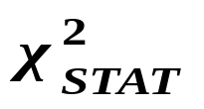
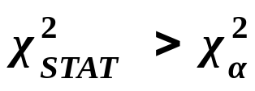
Decision Rule
The test statistic approximately follows a chi-squared distribution with (r – 1)(c – 1) degrees of freedom
Decision Rule:
If , reject H₀, otherwise, do not reject H₀
α
0
χ²
Do not
reject H₀
Reject H₀
χ²_{α}
Chap 12-<number>

Slide 10
Special case: two proportions
Example: Gender vs Lefthandedness
Gender | Hand Preference
 | Left | Right
Female | Observed = 12 Expected = 14.4 | Observed = 108 Expected = 105.6 | 120
Male | Observed = 24 Expected = 21.6 | Observed = 156 Expected = 158.4 | 180
 | 36 | 264 | 300
Chap 12-<number>

Slide 11
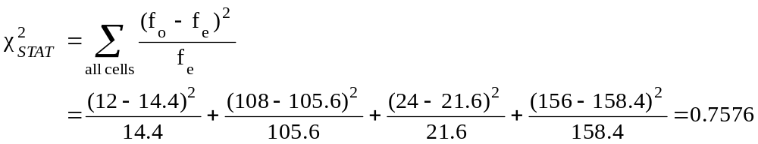
The Chi-Square Test Statistic
Gender | Hand Preference
 | Left | Right
Female | Observed = 12 Expected = 14.4 | Observed = 108 Expected = 105.6 | 120
Male | Observed = 24 Expected = 21.6 | Observed = 156 Expected = 158.4 | 180
 | 36 | 264 | 300
The test statistic is:
Chap 12-<number>

Slide 12
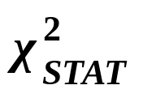
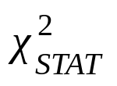
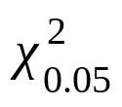
Decision Rule
Decision Rule:
If > 3.841, reject H₀, otherwise, do not reject H₀
Here,
= 0.7576< = 3.841,
so we do not reject H₀ and conclude that there is not sufficient evidence that the two proportions are different at α = 0.05
0.05
0
χ²
Do not
reject H₀
Reject H₀
χ²_{0.05} = 3.841
Chap 12-<number>

Slide 13
Examples
# 12.3
# 12.10

Slide 14
Special case: more than two proportions
More than two independent populations
Test
H₀: π₁ = π₂ = … = π_{c}
H₁: Not all of the π_{j} are equal (j = 1, 2, …, c)
Chap 12-<number>

Slide 15
Example: c = 3 categories
H₀: π₁ = π₂ = π₃
H₁: Not all of the π_{j} are equal (j = 1, 2, 3)
Chi-Square Test: Administrators, Students, Faculty
Admin Students Faculty Total
Favor 63 20 37 120
60 30 30
Oppose 37 30 13 80
40 20 20
Total 100 50 50 200
Observed
Expected
Chap 12-<number>

Slide 16
Examples
# 12.12
## 12.16-12.17
Chap 12-<number>

Slide 17
General case of r x c table
Example: the meal plan selected by 200 students
Class Standing | Number of meals per week |  |  | Total
 | 20/week | 10/week | none
Fresh. | 24 | 32 | 14 | 70
Soph. | 22 | 26 | 12 | 60
Junior | 10 | 14 | 6 | 30
Senior | 14 | 16 | 10 | 40
Total | 70 | 88 | 42 | 200
Chap 12-<number>

Slide 18
Null and alternative hypotheses
The hypothesis to be tested is:
H₀: Meal plan and class standing are independent
(i.e., there is no relationship between them)
H₁: Meal plan and class standing are dependent
(i.e., there is a relationship between them)
Chap 12-<number>

Slide 19
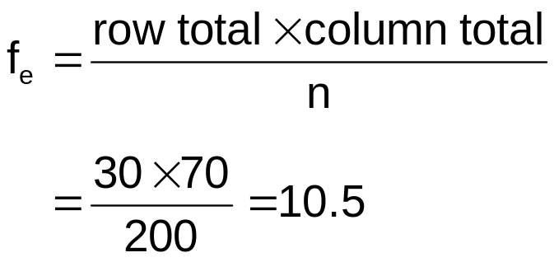
Expected Cell Frequencies
Observed:
Class Standing | Number of meals per week |  |  | Total
 | 20/wk | 10/wk | none
Fresh. | 24 | 32 | 14 | 70
Soph. | 22 | 26 | 12 | 60
Junior | 10 | 14 | 6 | 30
Senior | 14 | 16 | 10 | 40
Total | 70 | 88 | 42 | 200
Expected cell frequencies if H₀ is true:
Class Standing | Number of meals per week |  |  | Total
 | 20/wk | 10/wk | none
Fresh. | 24.5 | 30.8 | 14.7 | 70
Soph. | 21.0 | 26.4 | 12.6 | 60
Junior | 10.5 | 13.2 | 6.3 | 30
Senior | 14.0 | 17.6 | 8.4 | 40
Total | 70 | 88 | 42 | 200
Example for one cell:
Chap 12-<number>

Slide 20
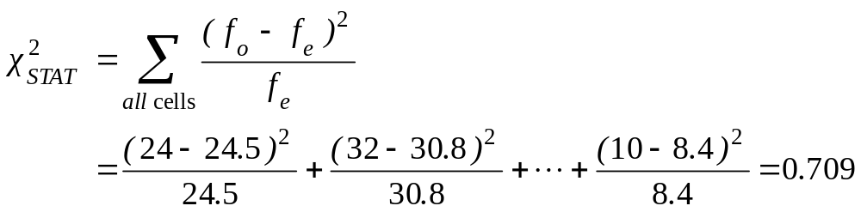
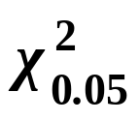
The Test Statistic
The test statistic value is:
= 12.592 from the chi-squared distribution with (4 – 1)(3 – 1) = 6 degrees of freedom
Chap 12-<number>

Slide 21

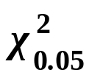
Decision and Interpretation
(continued)
Decision Rule:
If > 12.592, reject H₀, otherwise, do not reject H₀
0.05
Here,
= 0.709 < = 12.592,
so do not reject H₀
Conclusion: there is not sufficient evidence that meal plan and class standing are related at α = 0.05
0
χ²
Do not
reject H₀
Reject H₀
χ²_{0.05}=12.592
Chap 12-<number>

Slide 22
Examples
# 12.20
# 12.24
Chap 12-<number>

Slide 23
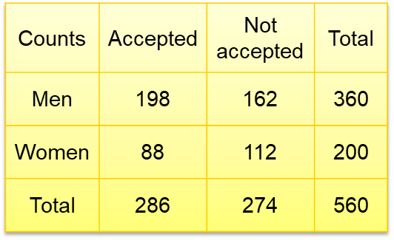
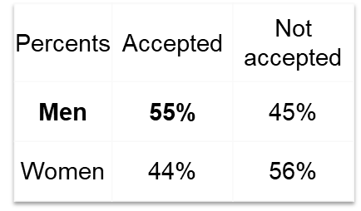
Simpson’s Paradox
Consider the acceptance rates for the following groups of men and women who applied to college.
A higher percentage of men were accepted: Is there evidence of discrimination?

Slide 24
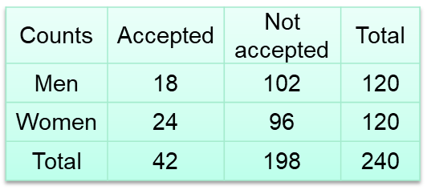
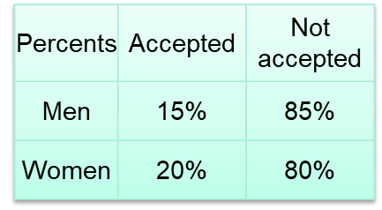
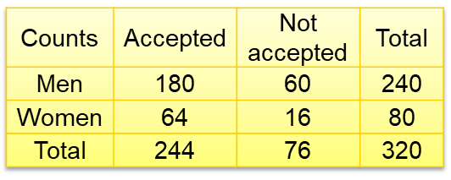
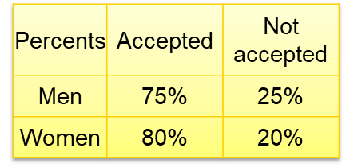
Simpson’s Paradox
Consider the acceptance rates when broken down by type of school.
BUSINESS SCHOOL
ART SCHOOL

Slide 25
Chapter Summary
In this chapter we discussed
Applying the χ² test for the difference between two proportions
Applying the χ² test for differences in more than two proportions
Applying the χ² test for independence
Chap 12-<number>

